Slide 1
Prediction Model of Movies’ Revenue
Mingjun Sun

Slide 2
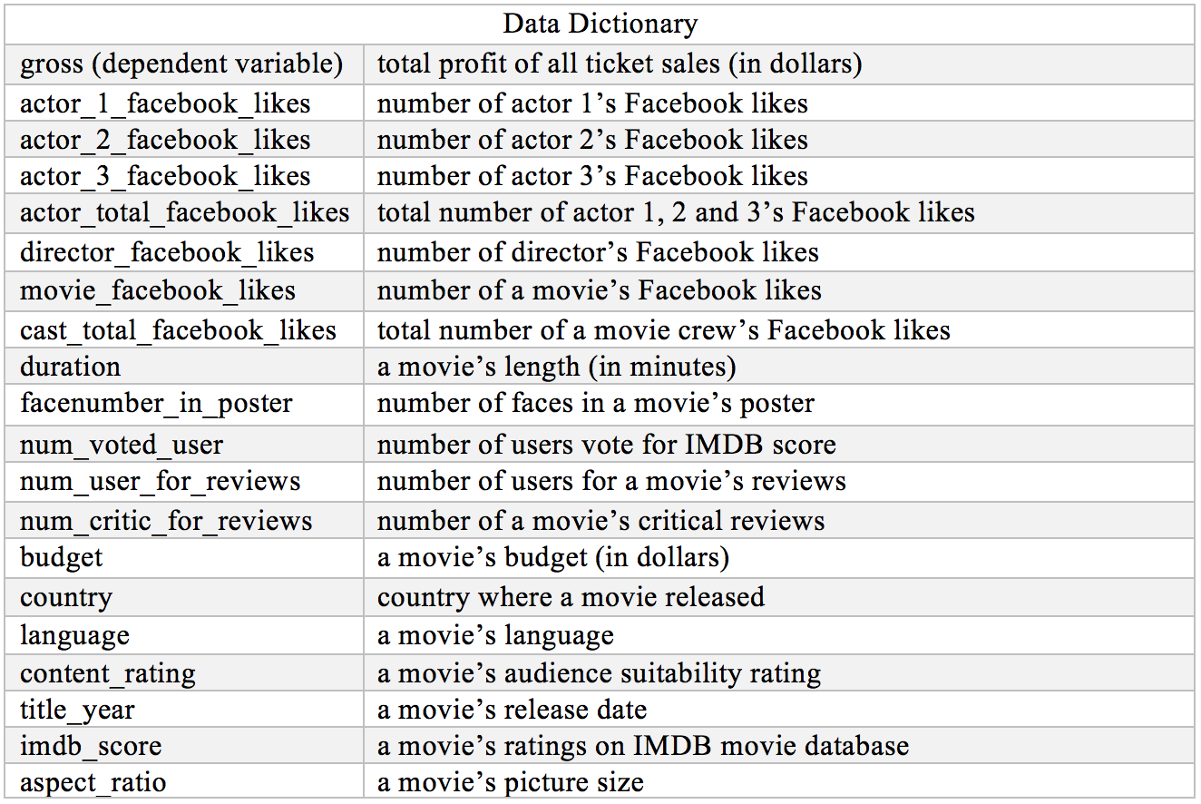
Dataset Information

Slide 3

Data Cleaning
Missing Values
Unreachable Data
Outliers
Dummy Variable
String Data => Numerical Data
Illogical Information
Correlation

Slide 4
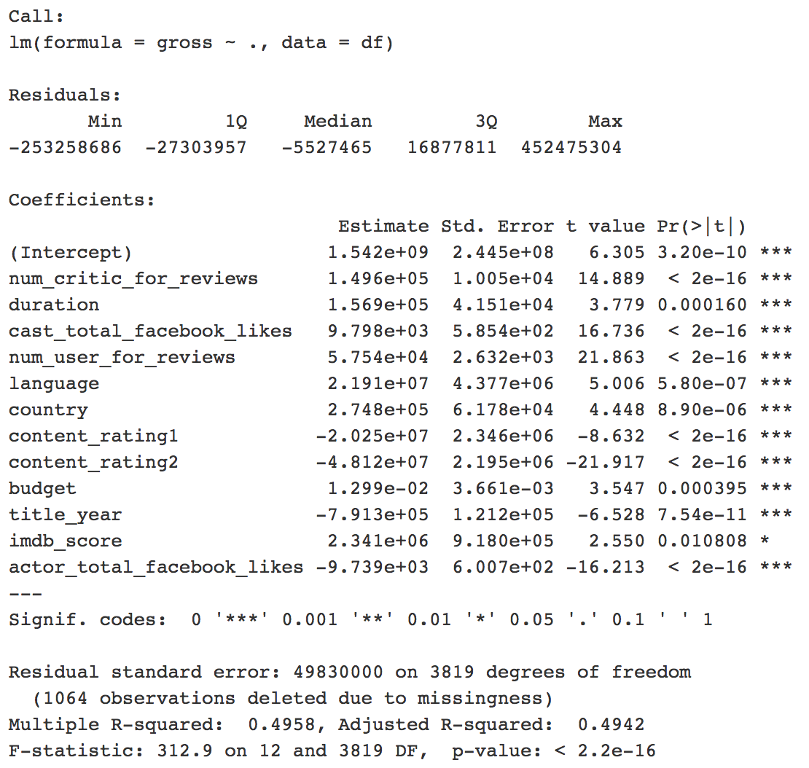
Linear Regression Model

Slide 5

My Recommendations
Invite famous actors/actresses
Increase budgets within an acceptable range
An effective marketing plan

Slide 6
Q & A

